Slide 1


CHALGRAVE MANOR
SOLAR FARM
Chalton Parish Council Meeting
Monday 5th September 2022
Robinson & Hall LLP
Mr Abel Bunu
Principal Planner BSC HRUP,MSC, MRTPI
Aton Energy Ltd
Mr Nicolas Martin
Head of Project Development

Slide 2
RE-SUBMISSION OF APPLICATION CB/20/03856/FULL
Location: Chalgrave Manor, Fancott, Luton Road LU5 6HT
History of the Project:
In 2015, received Planning Consent from Development Planning Committee for Solar Farm over 39 hectares
In 2021, received Planning Consent from Development Planning Committee with the same features but 1 year time limit
The Applicant aims to RE-SUBMIT a new full application around Mid-September 2022.

Slide 3
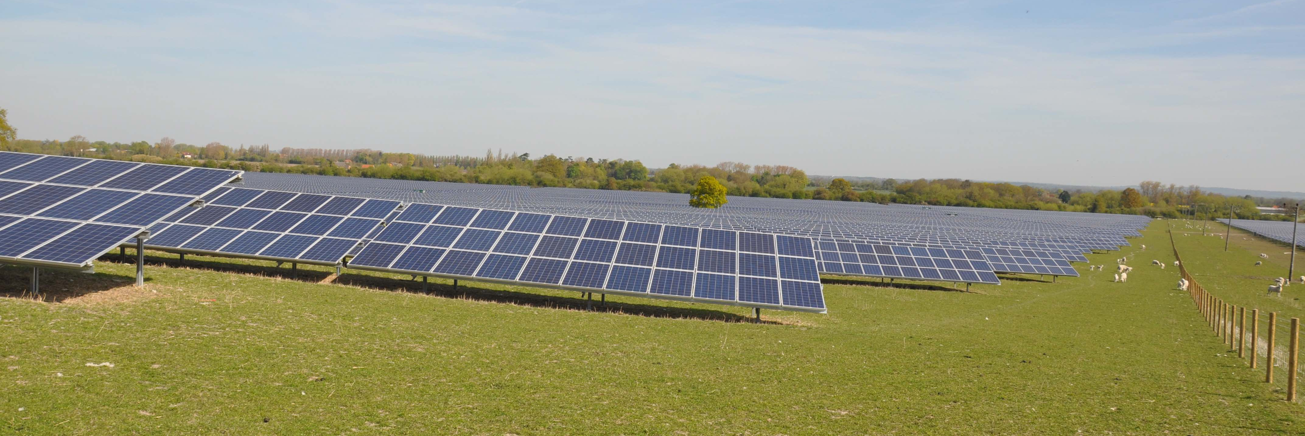
Proposed Development: the Applicant is proposing the installation of Photovoltaic (PV) panels, inverters & connection stations, fencing, CCTV cameras and temporary construction compound on 39 hectares.
The Applicant: Aton Energy is a Renewable Project Developer established in 2008, focused on solar ground and roof projects as well as battery energy project.
Since 2010, Aton developed over 500MW of solar ground and roof project including:
Ground:
Bowerhouse 30 MWp – Somerset
Elms Farm 30 MWp – Oxfordshire
Wickham Market 50 MWp – Suffoalk
Rooftop:
WV Dordon Center 3 MWp
Yeo Valley Center 4 MWp
Elms Farm Solar Farm

Slide 4
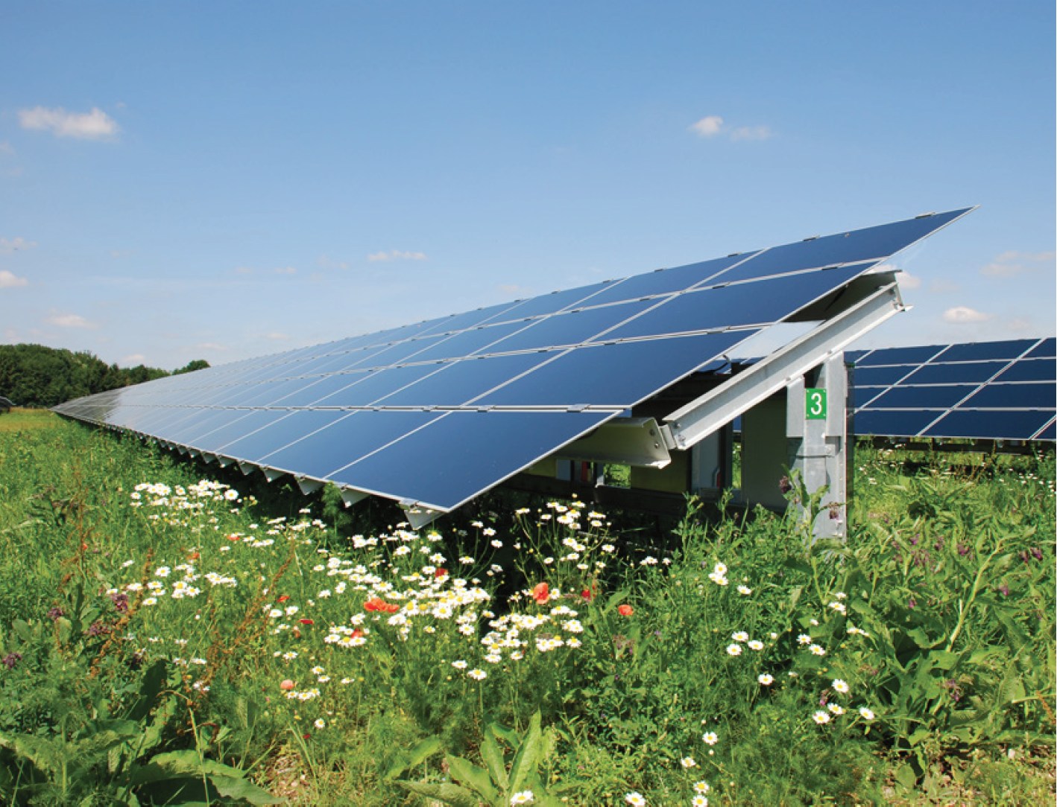


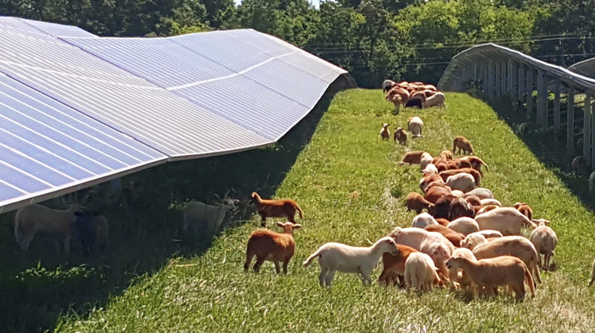
GENERATION OF LOCAL CLEAN ENERGY TO HELP CLIMATE CHANGE AND SUPPORT UK ENERGY SECURITY
Chalgrave Manor Solar Farm would generate the equivalent of
15,000 family homes
Displace 15,650 tonnes
of CO2 emissions
BIODIVERSITY GAIN
Introduction of areas of meadow will replace intensive farming, eradicate fertilizer and pesticide use, advancing the quality of both land and waterways.
Sheep grazing underneath solar panels.
Providing a minimum of 10% Net Biodiversity Gain

Slide 5
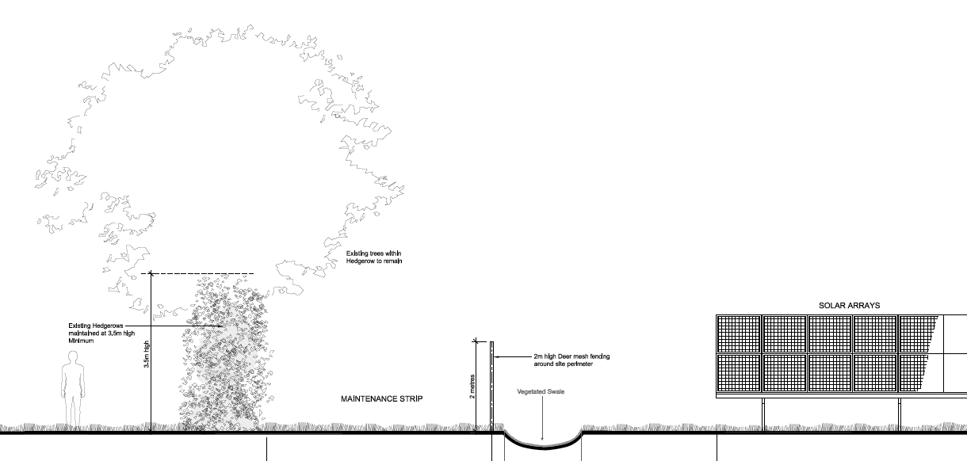
LANDSCAPING
A Landscape Management Plan is agreed with the Landscape and the Tree Officers, including :
No solar panels on the slope to limit visibility
No removal of existing hedgerows or trees
Enhancement or creation of natural fillers to screen the site with 5m space around perimeter fence
8m wide space where matured trees i.e. Eastern Boundary and along FP28 (North West)

Slide 6
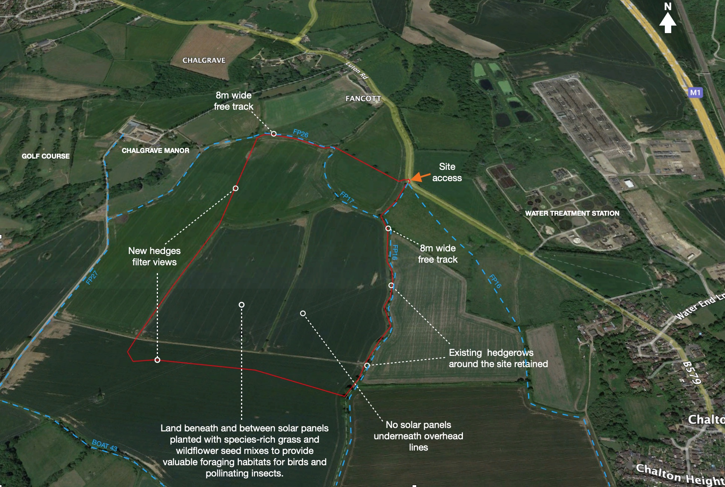
Landscaping Management features

Slide 7
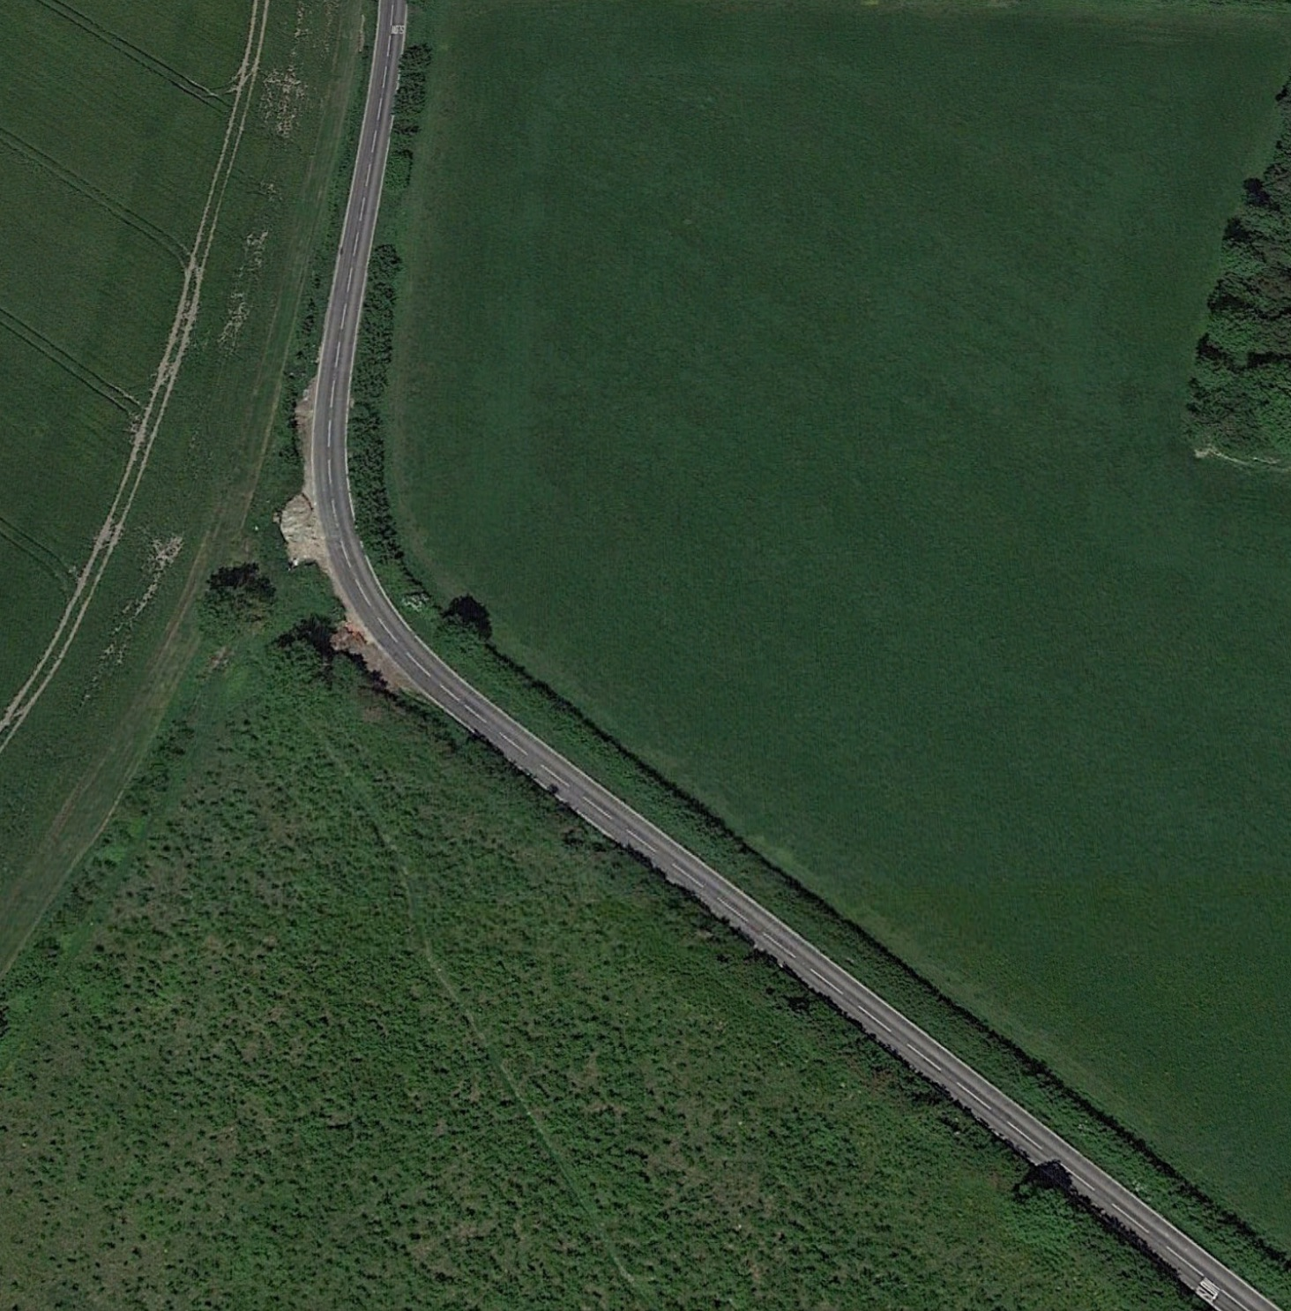
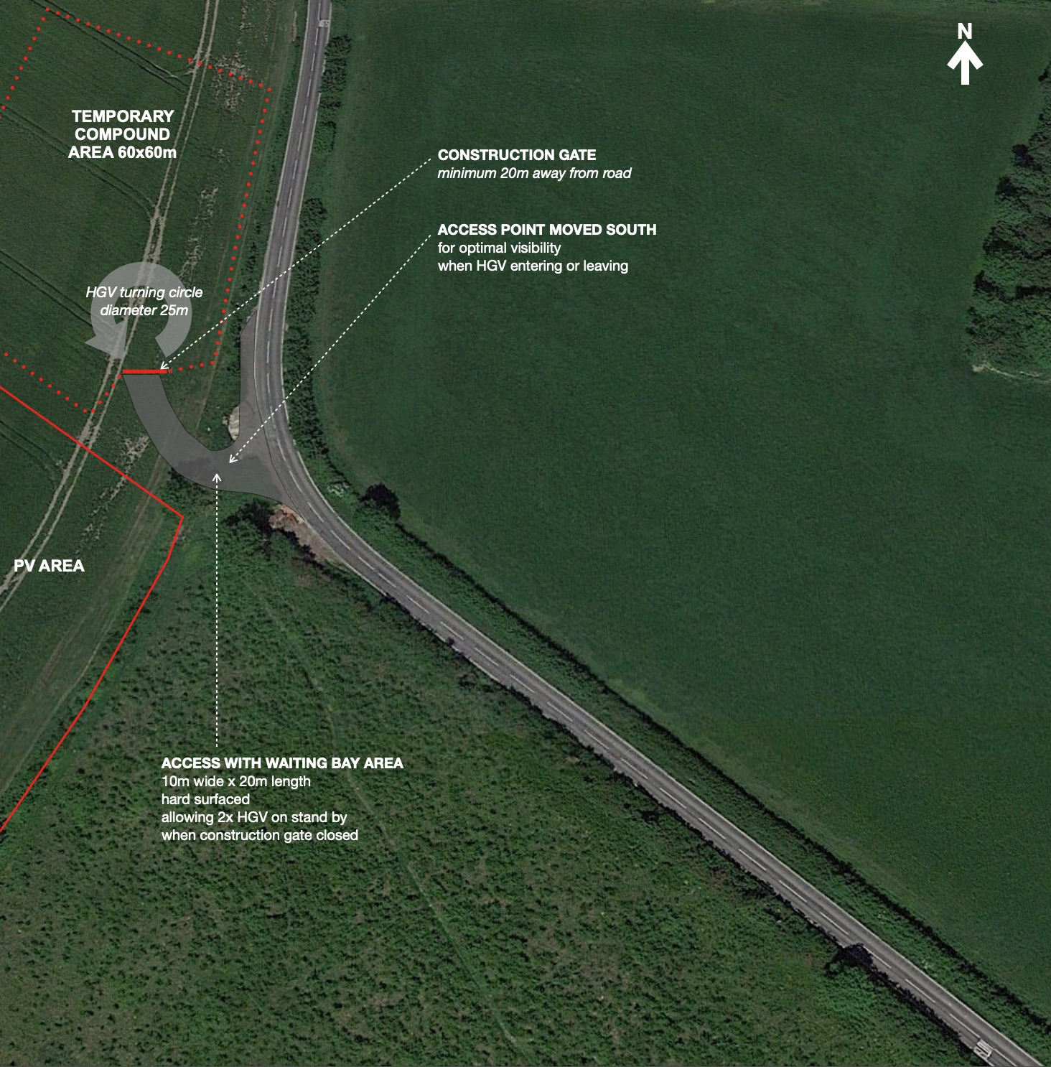
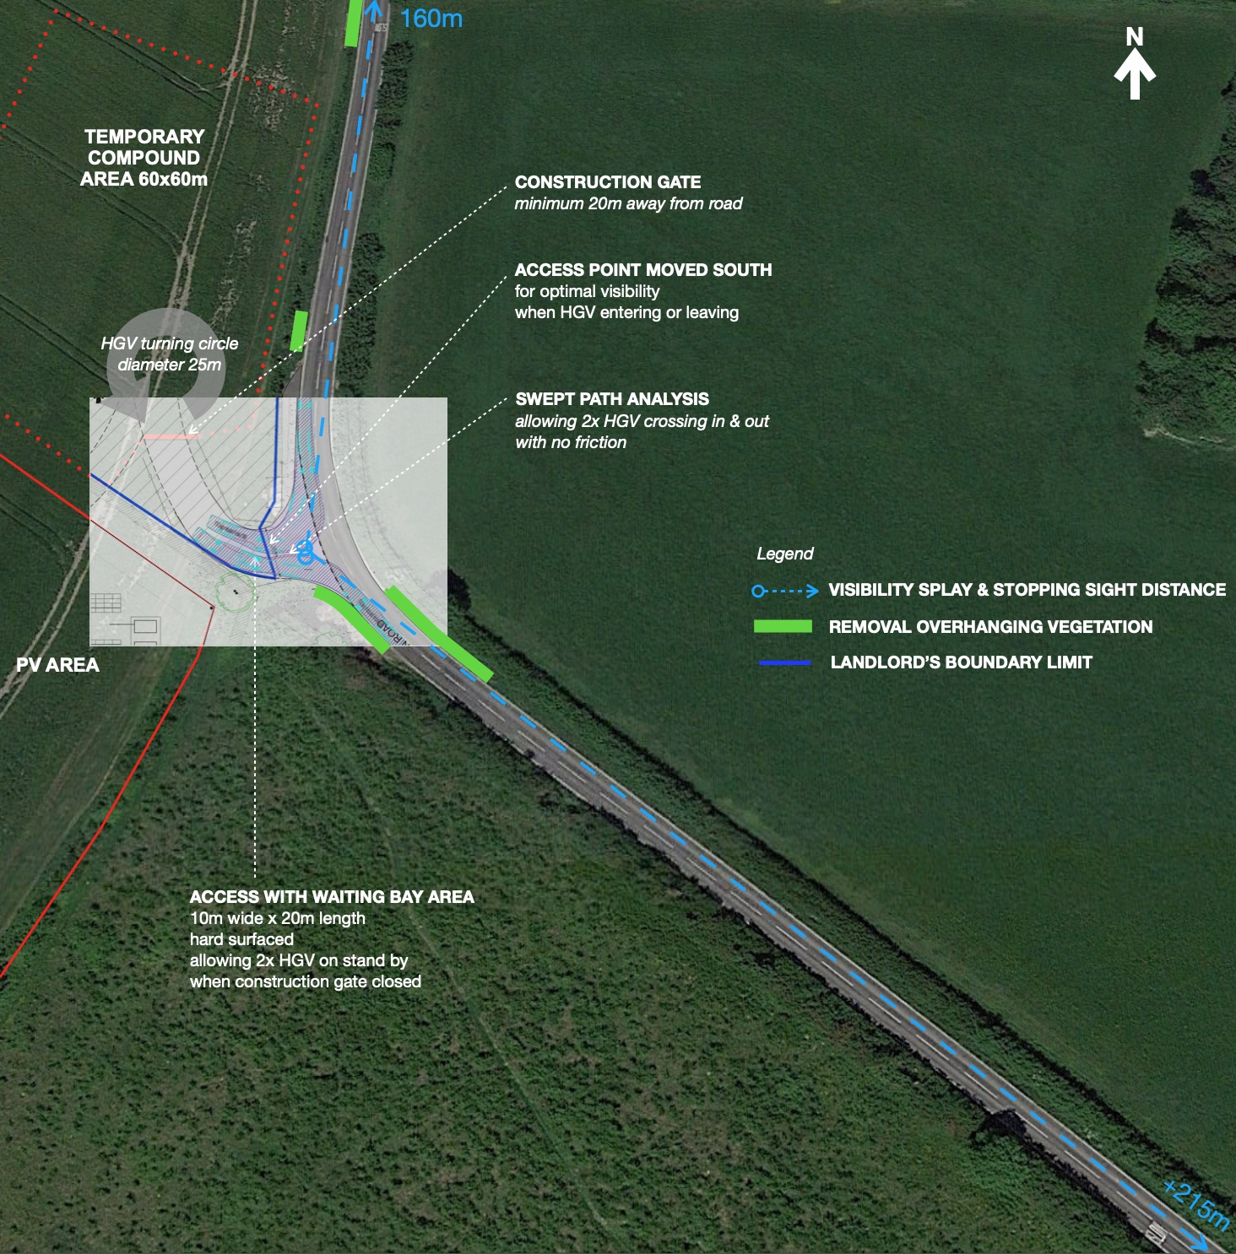
ACCESS
Highway improvements are agreed with the Highway Officer.
All HGVs & vehicles:
Arriving from South (from Junction 11a)
Exiting towards North (to Junction 12)

Slide 8
COMMUNITY INVOLVEMENT
Since August 23rd, dedicated website has been updated with a page for feedback or suggestions
Emails have been sent to Councillors, neighbours or stakeholders involved in the former application
Face-to-face meeting with Chalton Parish Council on Sept 5th (Today)
Face-to-face meeting with Chalgrave Parish Council on Sept 20th
Public event on September 20th at the Chalton Village Hall and display of feedback forms
Distribution of leaflets to residents from Chalton, Chalgrave and Toddington with feedback forms
COMMUNITY BENEFITS
£100,000 contribution of to a Community Fund over the lifetime of the project
Free installation of free solar PV equipment on local schools: Chalton & Chalgrave
Free educational material to be provided to the local schools
Protection and enhancement of the Public Footpath
Two educational boards on permanent display around the solar farm

Slide 9
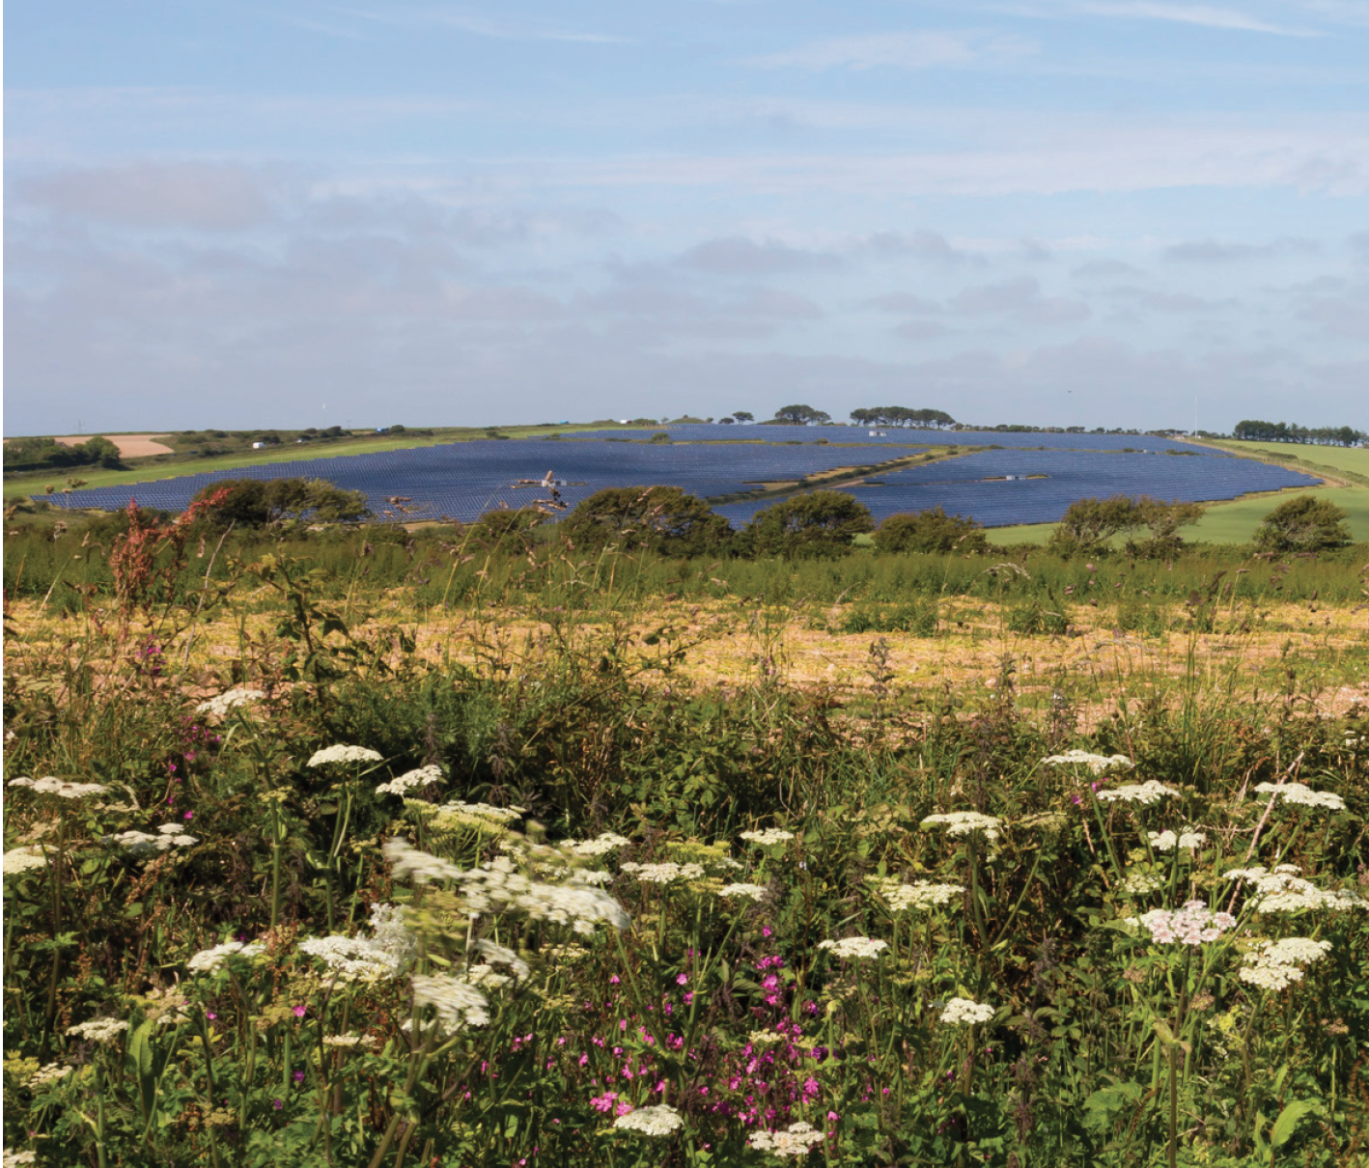
THANK YOU.

